Slide 1
Exception:
An Exception is an unwanted event (Run Time Errors) that interrupts the normal flow of the program. When an exception occurs program execution gets terminated.
In such cases we get a system generated error message.
By handling the exceptions java provides a meaningful message to the user about the issue, rather than a system generated message, which may not be understandable to a user.

Slide 2
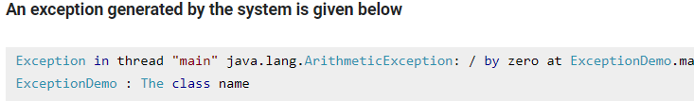
Exception Handling
If an exception occurs, which has not been handled by programmer then program execution gets terminated and a system generated error message is shown to the user.

Slide 3
Advantage of Exception Handling
Exception handling ensures that the flow of the program doesn’t break when an exception occurs.
For example: if a program has bunch of statements and an exception occurs mid way after executing certain statements then the statements after the exception will not execute and the program will terminate abruptly.

Slide 4
Types of Exceptions
There are two types of exceptions in Java: 1)Checked exceptions 2)Unchecked exceptions
1:Checked Exceptions (Depends on Outer Resources)
All exceptions other than Runtime Exceptions are known as Checked exceptions as the compiler checks them during compilation to see whether the programmer has handled them or not. If these exceptions are not handled/declared in the program, you will get compilation error.
For example:
SQLException
IOException
ClassNotFoundException etc.

Slide 5
Unchecked Exceptions
Runtime Exceptions are also known as Unchecked Exceptions. These exceptions are not checked at compile-time so compiler does not check whether the programmer has handled them or not but it’s the responsibility of the programmer to handle these exceptions and provide a safe exit.
For example:
ArithmeticException
NullPointerException
ArrayIndexOutOfBoundsException

Slide 6
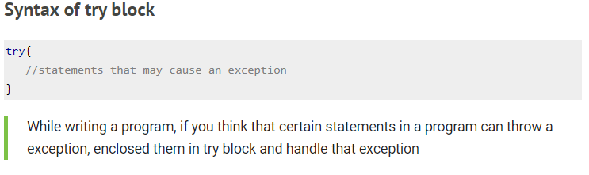
Try block
The try block contains set of statements where an exception can occur. A try block is always followed by a catch block, which handles the exception that occurs in associated try block. A try block must be followed by catch blocks or finally block or both.

Slide 7
Catch Block
A catch block is where you handle the exceptions, this block must follow the try block. A single try block can have several catch blocks associated with it. You can catch different exceptions in different catch blocks. When an exception occurs in try block, the corresponding catch block that handles that particular exception executes. For example if an arithmetic exception occurs in try block then the statements enclosed in catch block for arithmetic exception executes.

Slide 8
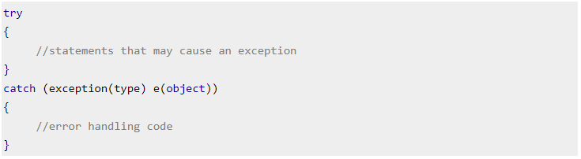
Syntax of “try – catch” in java

Slide 9
class Example1
{ public static void main(String args[])
{ int num1, num2;
try {
num1 = 0; num2 = 62 / num1;
System.out.println(num2);
System.out.println("Hey I'm at the end of try block");
}
catch (ArithmeticException e)
{ /* This block will only execute if any Arithmetic exception * occurs in try block */
System.out.println("You should not divide a number by zero");
}
catch (Exception e)
{ /* This is a generic Exception handler which means it can handle * all the exceptions.
This will execute if the exception is not * handled by previous catch blocks.
System.out.println("Exception occurred"); }
System.out.println("I'm out of try-catch block in Java.");
}
}

Slide 10
Multiple “catch” blocks in Java
A single try block can have any number of catch blocks.
A generic catch block can handle all the exceptions. Whether it is ArrayIndexOutOfBoundsException OR ArithmeticException OR NullPointerException OR any other type of exception.
If no exception occurs in try block then the catch blocks are completely ignored.
Corresponding catch blocks execute for that specific type of exception:
catch(ArithmeticException e) is a catch block that can hanlde ArithmeticException catch(NullPointerException e) is a catch block that can handle NullPointerException

Slide 11
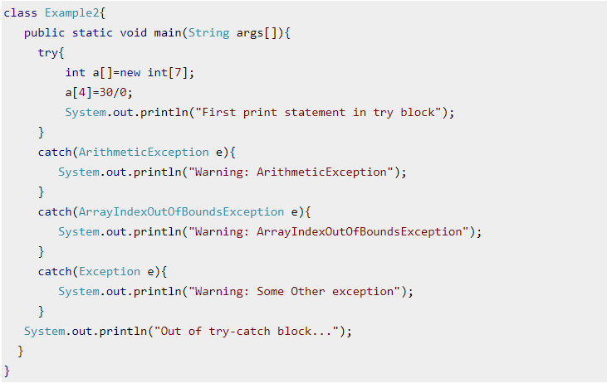
Example of Multiple catch blocks

Slide 12
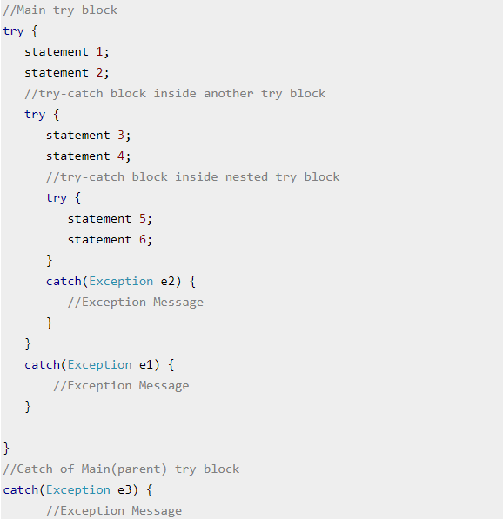
Nested try catch block in Java

Slide 13
finally block – Exception Handling
A finally block contains all the crucial statements that must be executed whether exception occurs or not. The statements present in this block will always execute regardless of whether exception occurs in try block or not such as closing a connection, stream etc

Slide 14
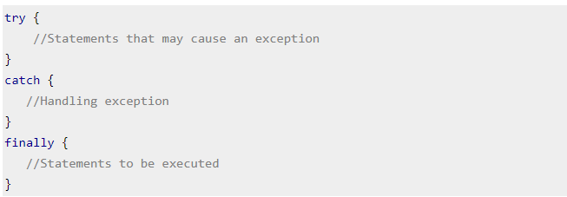
Syntax of finally Block

Slide 15
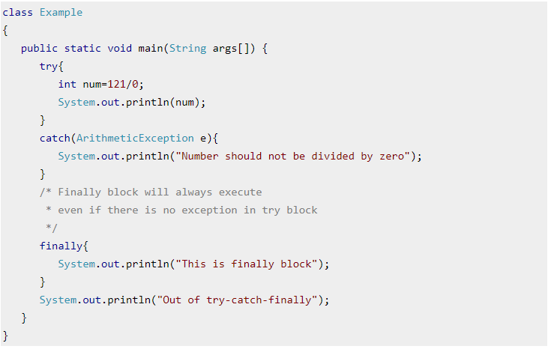
Example of finally Block

Slide 16
The “try-with-resources” statement Interview Question (8 LPA)
In Java, the try-with-resources statement is a try statement that declares one or more resources. The resource is as an object that must be closed after finishing the program. The try-with-resources statement ensures that each resource is closed at the end of the statement execution.
You can pass any object that implements java.lang.AutoCloseable, which includes all objects which implement java.io.Closeable.
The following example writes a string into a file. It uses an instance of FileOutputStream to write data into the file. FileOutputStream is a resource that must be closed after the program is finished with it. So, in this example, closing of resource is done by itself try.

Slide 17
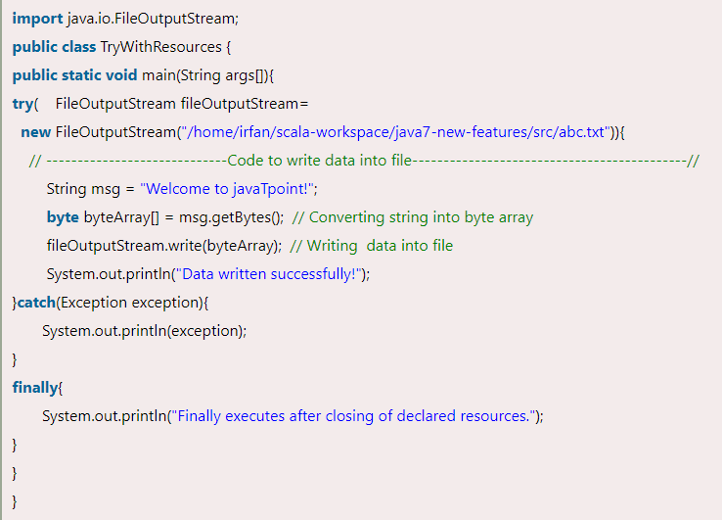
Example: (try with resource)

Slide 18
Java 9: Try With Resource Enhancement
Java introduced try-with-resource feature in Java 7 that helps to close resource automatically after being used.
In other words, we can say that we don't need to close resources (file, connection, network etc) explicitly, try-with-resource close that automatically by using AutoClosable interface.
In Java 7, try-with-resources has a limitation that requires resource to declare locally within its block

Slide 19
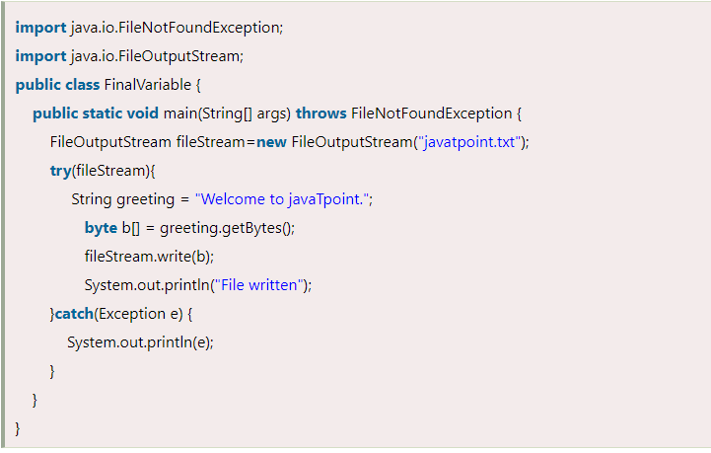
Java 7 Resource declared outside the resource block If we do like the following code in Java 7, compiler generates an error message.

Slide 20
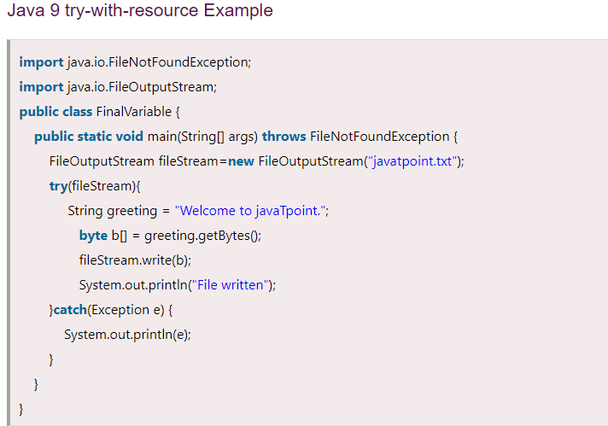
To deal with this error, try-with-resource is improved in Java 9 and now we can use reference of the resource that is not declared locally. In this case, if we execute the above program using Java 9 compiler, it will execute nicely without any compile error.

Slide 21
THANKS

